Slide 1
WELCOME
Mrs. Nancy Scott
Second Grade

Slide 2
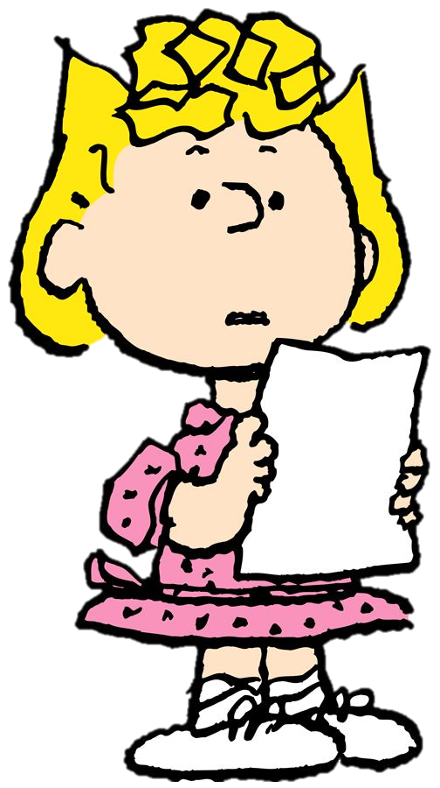
Things To Be Discussed
Introduction
Schedule
Supplies
Information About Canvas, Links, etc.
What to expect if your child is switched to virtual
Social Distance, face mask, checking temperatures, etc.
School and classroom safety

Slide 3
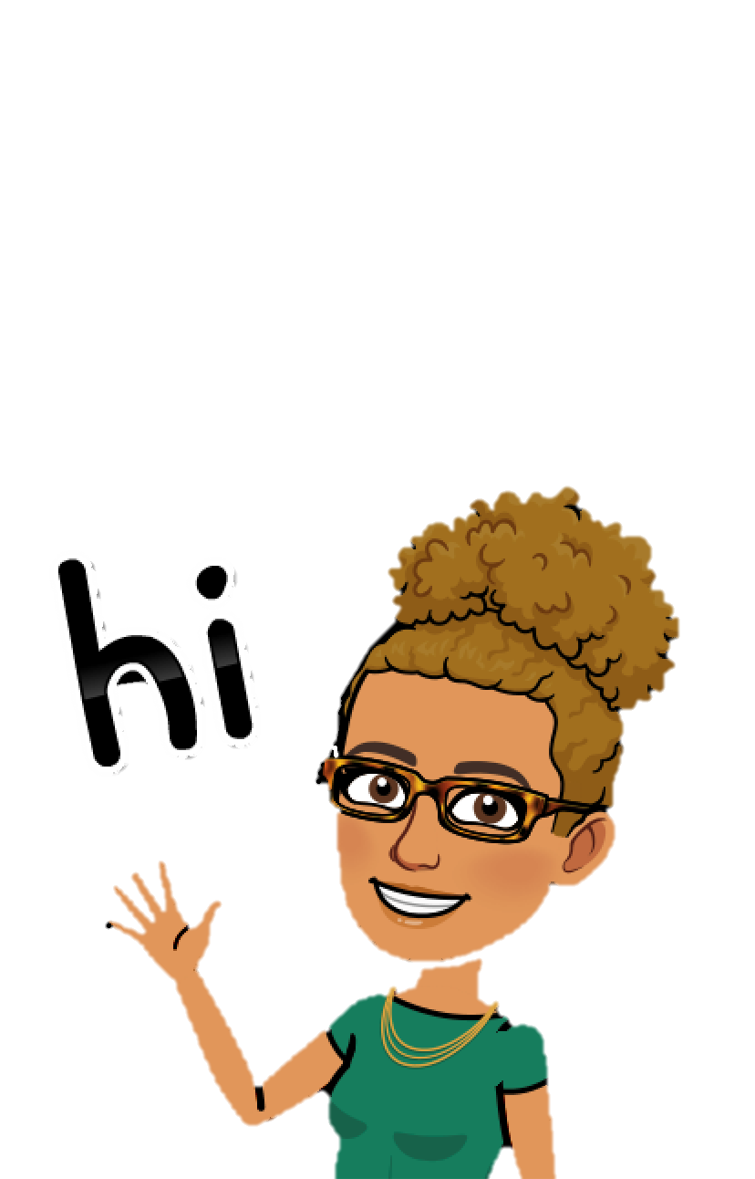
Meet
Mrs. Scott

Slide 4
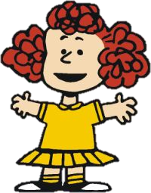
Introduction
Hello, my name is Mrs. Nancy Scott and I will be teaching second grade. This will be my first time teaching second grade but I have taught third, kindergarten, and head start. I have been working within the school system for over 9 years, six in Virginia, and the remainder here in Georgia. I have also been a teachers assistant for four years. I look forward to a very exciting and fun school year.

Slide 5
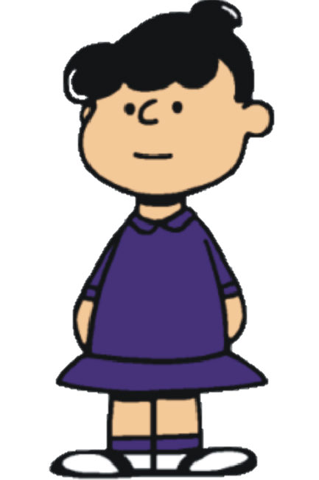
Schedule
8:00 -8:30 SEL
8:30 – 9:15 Connections
9:15 – 11:30 ELA/Writing Block
11:30 – 12:00 ELA Intervention
12:00 – 12:30 Lunch
12:35 – 12:50 Recess/Break
12:50 – 1:30 Science/Social Studies
1:30 – 2:45 Math Block
2:45 – 3:15 Math Intervention
3:15 - Dismissal

Slide 6
Important Times
8:15 Tardy Bell
8:30-9:15 Connections
12:30-12:50 Recess
12:00-12:30 Lunch
3:15 Dismissal

Slide 7
Supplies
12 Ticonderoga pencils
2 Large erasers
2 Pack Dry erase markers
4 Large glue sticks
24 count crayons
1 pair Fiskars scissors
2 composition notebooks(marble cover)
2 pocket folders
2 spiral notebooks
1 set headphones
4 boxes tissue (or more)
1 pencil pouch (no pencil boxes)
1 book bag/backpack

Slide 8
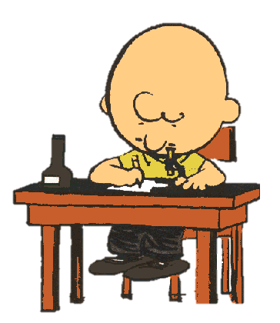
Homework
Homework will be sent home. Please check your child’s folder on a daily basis for homework and other important information.

Slide 9
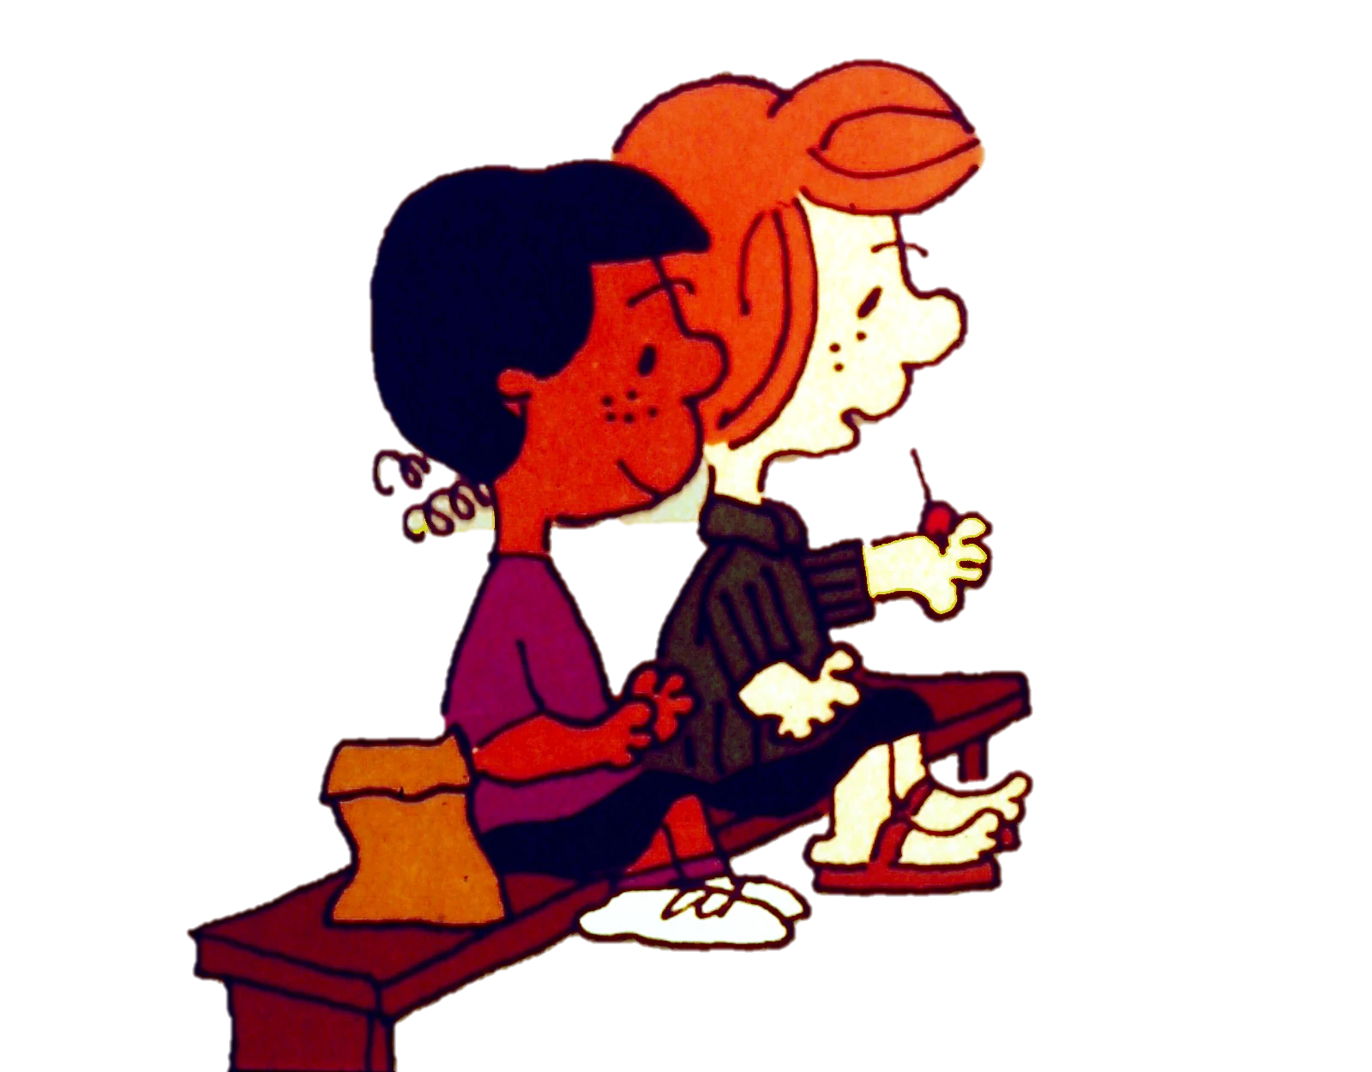
Social Distancing
We at A. B. Merry will have all students social distancing, wearing masks, and taking temperatures each and everyday and would like it if you will have a conversation with your child about how important it is to keep up good rituals and routines when it comes to being safe each and everyday.

Slide 10
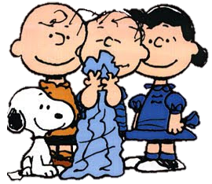
School Safety
At A.B. Merry there will be sanitation stations throughout the building where students can go and sanitize their hands during the day. Also, within the classroom, I will have areas where the student can sanitize and wash their hands. We want to have a great year where everyone is safe.

Slide 11
Any Questions?
I’m looking forward to a great year with you!!

